Slide 1
Alignments: Purpose, Assessment and Application
Jill Pecon Slattery, Ph.D.
slatteryjp@si.edu
www.cornerstonegenomics.com

Slide 2
Introduction
Purpose
Alignments are an essential, critical step before proceeding to population genetic or phylogenetic analyses with mitochondrial, plastid, or genomic sequence data
What is an Alignment?
An alignment is a multiple sequence file of either nucleotide or amino acid residue data from a particular genomic region.
The alignment estimates identity by decent for each site within the sequence.
What Type of Data?
Nucleotide or protein sequence.
Type of Application?
Primer Design
Genome Mining Homology Searches for Marker Development
Population Structure and Phylogeography of a Species
Patterns of Speciation
Evolution of Gene Families
Identification of Gene Structure, Function and Evolution
Whole Genome Structure and Evolution
Interpretation of functional variants & ‘omics’: Transcriptome, proteome, resistome, metabolome, etc
Why Are Alignments So Important?

Slide 3
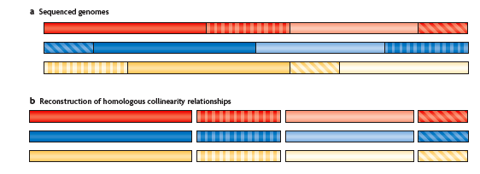
COMPARATIVE GENOME SEQUENCING AND ALIGNMENT
MARGULIES AND BIRNEY NAT REV 2008

Slide 4
Steps in Alignment Construction

Slide 5
The Alignment Process Features-Progressive Alignment
Sub-segments (local alignment)
Fragment of sequence
Searching data base
BLAST
Global Alignment
Entire sequence considered
Phylogenetics
Comparative Genomics

Slide 6
Minimizing the Differences
What does it take to convert one sequence into another?
Computation of Cost
Mismatch
Gaps
 | - | A | G | T | A
- | 0 | 0 | 0 | 0 | 0
A | 0 | 0 | 1 | 1 | 0
C | 0 | 1 | 1 | 1 | 1
C | 0 | 1 | 1 | 1 | 1
T | 0 | 1 | 1 | 0 | 1

Slide 7
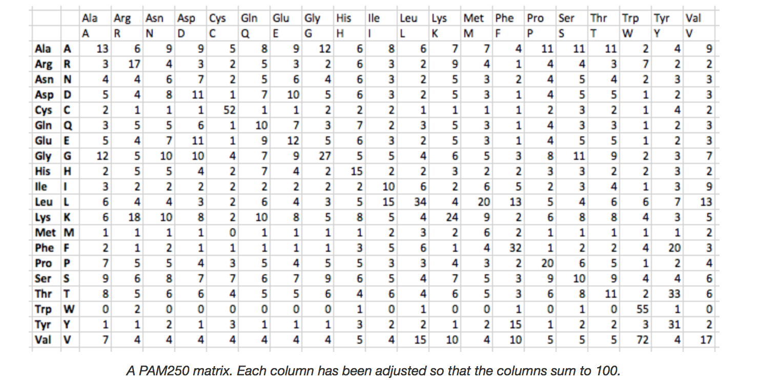
Cost for Mutation: Amino Acid Residues
How to estimate probability of one amino acid mutating into another.
Empirical Data Models
Models such as PAM-HOFF, JTT, WAG commonly used for nuclear proteins.
Organelle specific matrices:
MtREV
cpREV10, cpREV64
Pathogens
FLU Influenza
New advances are developing approaches that are scalable to deal with excessively large scale studies of protein families
Assumptions in constructing alignment minimize cost to preserve physical and chemical properties
New algorithms are benchmarked against databases such as BAliBase composed reference data aligned with 3D structure.

Slide 8
Multiple Alignment
Problem: True simultaneous alignment would be multi-dimensional and prohibitively computer intensive
Strategy:
Series of pairwise alignments combined into multiple alignments.
Guide trees constructed for intermediate levels of addition and tested.
Different alignment programs use different ways of creating the final multiple sequence file using both global and local methods
Traditional approach uses a progressive alignment based on evolutionary relationships of sequences
Iterative alignment methods (MCMC) that also include biological features to help align ( e.g. circular genomes)

Slide 9
Verification of Alignment
Critical Assessment
A priori knowledge about marker can help but is not essential
“ by eye”
Check insertion/deletions
Notorious problem motifs for alignment programs
Check divergent sequences
“Stochastic” alignment if sequences are too divergent
Check if known structures ignored
Protein or RNA secondary structures

Slide 10
Phylogenetic Consequences of Alignment: Nucleotide Data

Slide 11
Alignments 1: Transition:Transversion Bias
Nucleotides: A C G T
Adenine and Guanine (Purines)
Thymine and Cytosine (Pyrimidines)
A
C
T
G

Slide 12
Alignments 2: Among Site Rate Variation

Slide 13
Alignments 3: Nucleotide Frequency Bias
EMPIRICAL FREQUENCY
A C G T
GENOMIC REGION
ZFY INTRON 30.6 13.6 17.6 38.2
ZFY EXON 32.3 22.6 22.1 23.0
LENTIVIRUS POL GENE 42.4 12.8 19.8 24.9
LENTIVIRUS LTR 28.9 18.8 23.4 28.7

Slide 14
Alignment 4: Coding Regions
Codon Triplet: 1st, 2nd, 3rd Positions
Synonymous (dS) and Nonsynonymous (dN) Substitutions
Non-degenerate (2nd position): all encode nonsynonymous (amino acid altering) substitutions
Two-fold degenerate (1st position): both nonsynonymous and synonymous substitutions
Four-fold (3rd position): all synonymous
Selection
Non-neutral marker
dN/dS = ω
ω Neutral evolution
ω < 1 Purifying selection to maintain function
ω Positive selection for adaptation
Translation into amino acid residues to aid alignment
Ancient divergence events
Rapidly mutating genomes
Detection of selection in candidate marker
Identification of conserved motifs

Slide 15
Alignment 5: Recombination
Forms of Recombination During Chromosomal Pairing (Eukaryotes)
Conventional reciprocal exchange
Allelic between sister chromatids
Gene conversion (nonreciprocal exchange)
Donor and recipient
Allelic (between sister chromatids)
Non-allelic (between paralogous regions)
Forms of Recombination (Pathogens)/Horizontal gene transfer
Viruses (replication cycle in cells multiply infected with different strains)
Bacteria (transformation, transduction, conjugation)
Detection of Recombination in the Alignment (Host & Pathogens)
Motif: Stretch of contiguous sites within alignment
Programs to detect recombination motifs
RDP4, Martin et al 2015 (http://web.cbio.uct.ac.za/~darren/rdp.html)
List of other recombination detection programs
http://bioinf.man.ac.uk/robertson/recombination/programs.shtml
Phylogenetic approach with multiple sequences
Analyses of genes, partitioned chromosome region

Slide 16
Alignment 6: Insertion/Deletions
SIV/HIV alignment gp120: Hypervariable regions with excessive rates of insertion/deletion
Clustal Omega
PRANK+F
Phylogeny-Aware Gap Placement Prevents Errors in Sequence Alignment and Evolutionary Analysis Ari Löytynoja, et al. Science 320, 1632 (2008)

Slide 17
Recombinant Strain in Canine Distemper Virus
Yuan C, Liu W, Wang Y, Hou J, Zhang L, Wang G (2017) Homologous recombination is a force in the evolution of canine distemper virus. PLoS ONE 12(4): e0175416

Slide 18
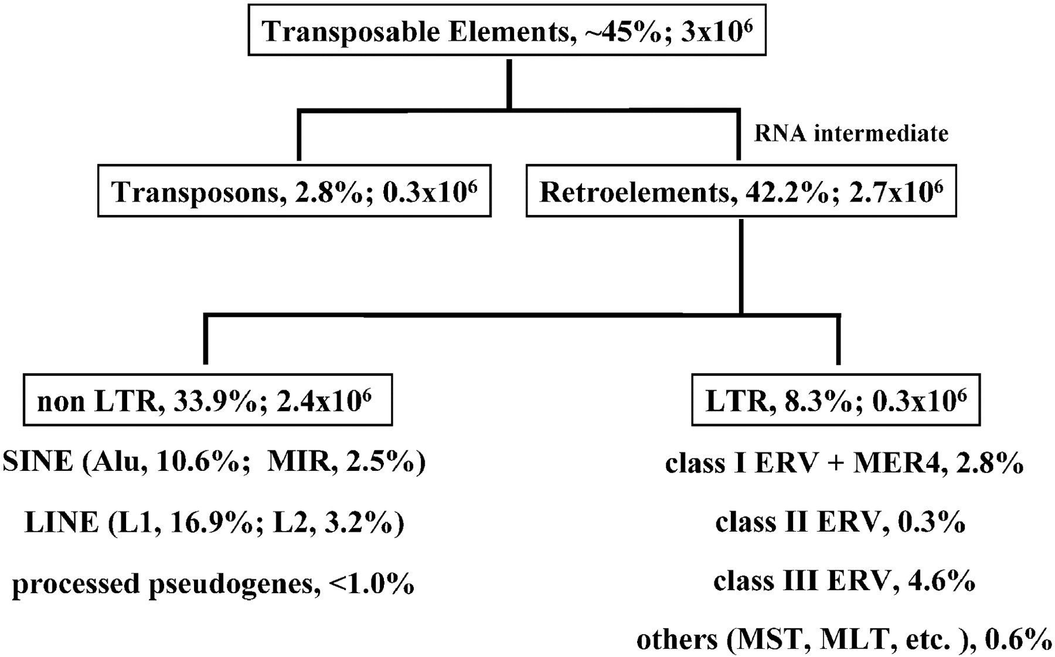
ALIGNMENT 7: TRANSPOSABLE ELEMENTS IN SEQUENCE
EXAMPLES FROM HUMAN GENOME

Slide 19
SINE Retroelements in Felidae

Slide 20
Rare Excision of SINE element in Puma Genome

Slide 21
Translation Alignment
Translates nucleotide files into amino acids
Aligns amino acids
Translates back to original nucleotides using the scaffold of amino acid alignment.
Beware: For highly divergent sequences, indels can induce artificial codon disruptions and stop codons
Example: TRANSLATER X, REVTRANS

Slide 22
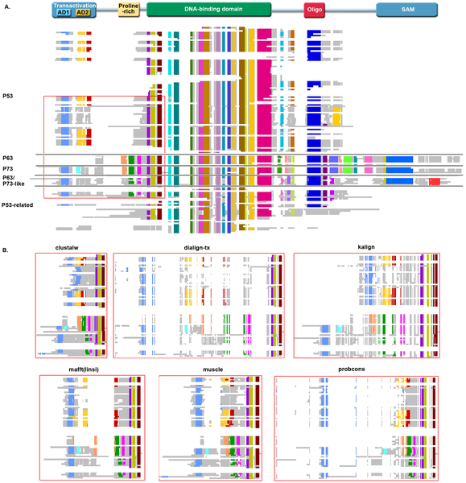

Which Alignment is Best?
Thompson JD, Linard B, Lecompte O, Poch O (2011) A Comprehensive Benchmark Study of Multiple Sequence Alignment Methods: Current Challenges and Future Perspectives. PLOS ONE 6(3): e18093. https://doi.org/10.1371/journal.pone.0018093
http://journals.plos.org/plosone/article?id=10.1371/journal.pone.0018093

Slide 23
Statistical Alignment
Important for full genome comparisons in whole genome sequencing projects where verification by eye not feasible.
Created to deal with ambiguities within alignment.
Jointly estimates alignment and phylogeny without potential bias of guide tree used in progessive alignments.
All possible alignments are considered
Bayesian framework to assess confidence using posterior probabilities
Recent 2017 study by Bugusz & Whelan (Syst. Biol) indicates performances differ over divergence time.
Notes:
Syst Biol (2017) 66 (2): 218-231

Slide 24
Statistical Alignment Programs
BAli-Phy: Bayesian Alignment and Phylogeny Estimation
BEAST: Bayesian Evolutionary Analysis Sampling Trees
Alifritz: Simultaneous Statistical Multiple Alignment and Phylogeny Reconstruction
DART: DNA, Amino and RNA Tests
StatAlign
PRANK: Probabilistic Alignment Kit
PaHMM-Tree

Slide 25
Scaling to accommodate excessively large datasets:
50,000-100,000 sequences
Programs such as PASTA, SATe-II, PHMM-Tree
Develop computational shortcuts
‘Evolutionary Aware’ constructing ‘correct’ Alignment and Tree Simultaneously

Slide 26
Post-Genomic Era: Issues in MSA Algorithms & Benchmarking
Scalability to accommodate large numbers of sequence of genomes
Unequal representation of taxa in genome databases (traditional model organisms)
Increased complexity of protein data & homology: multi-domains, large natively disordered regions, splicing transcripts unique to each new organism added to databases. While alignment programs might preferentially remove these regions, ignore vital functions of important motifs (signalling, post-translational modifications.
Pipeline programs designed to automatically predict new genes error prone (accuracy <50%)
Next gen sequencing producing flood of short reads not properly filtered—noisy data clogging up genome datasets

